Slide 1


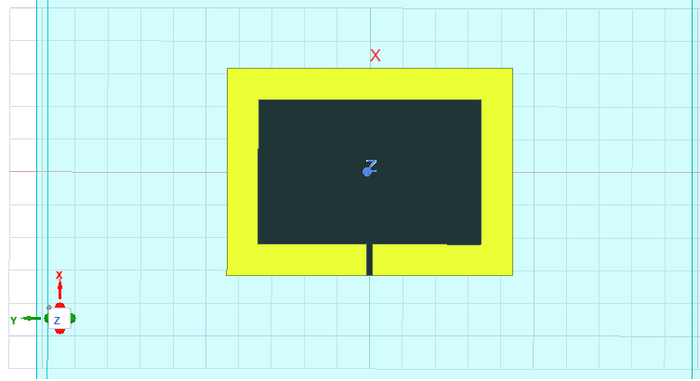
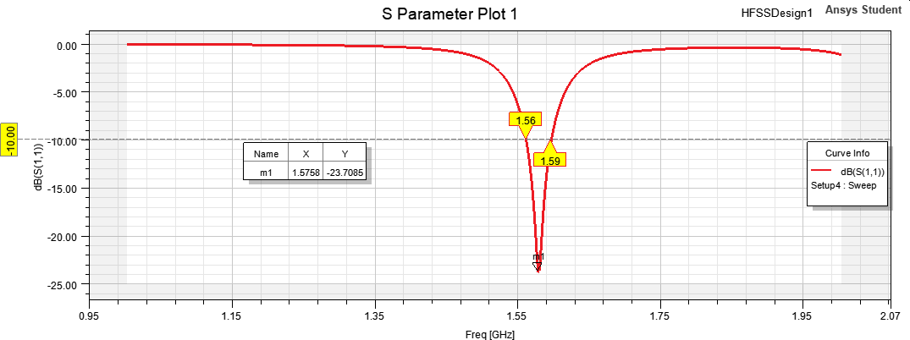
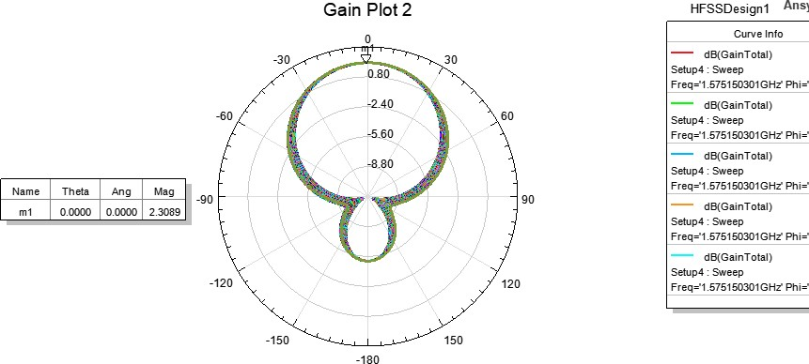
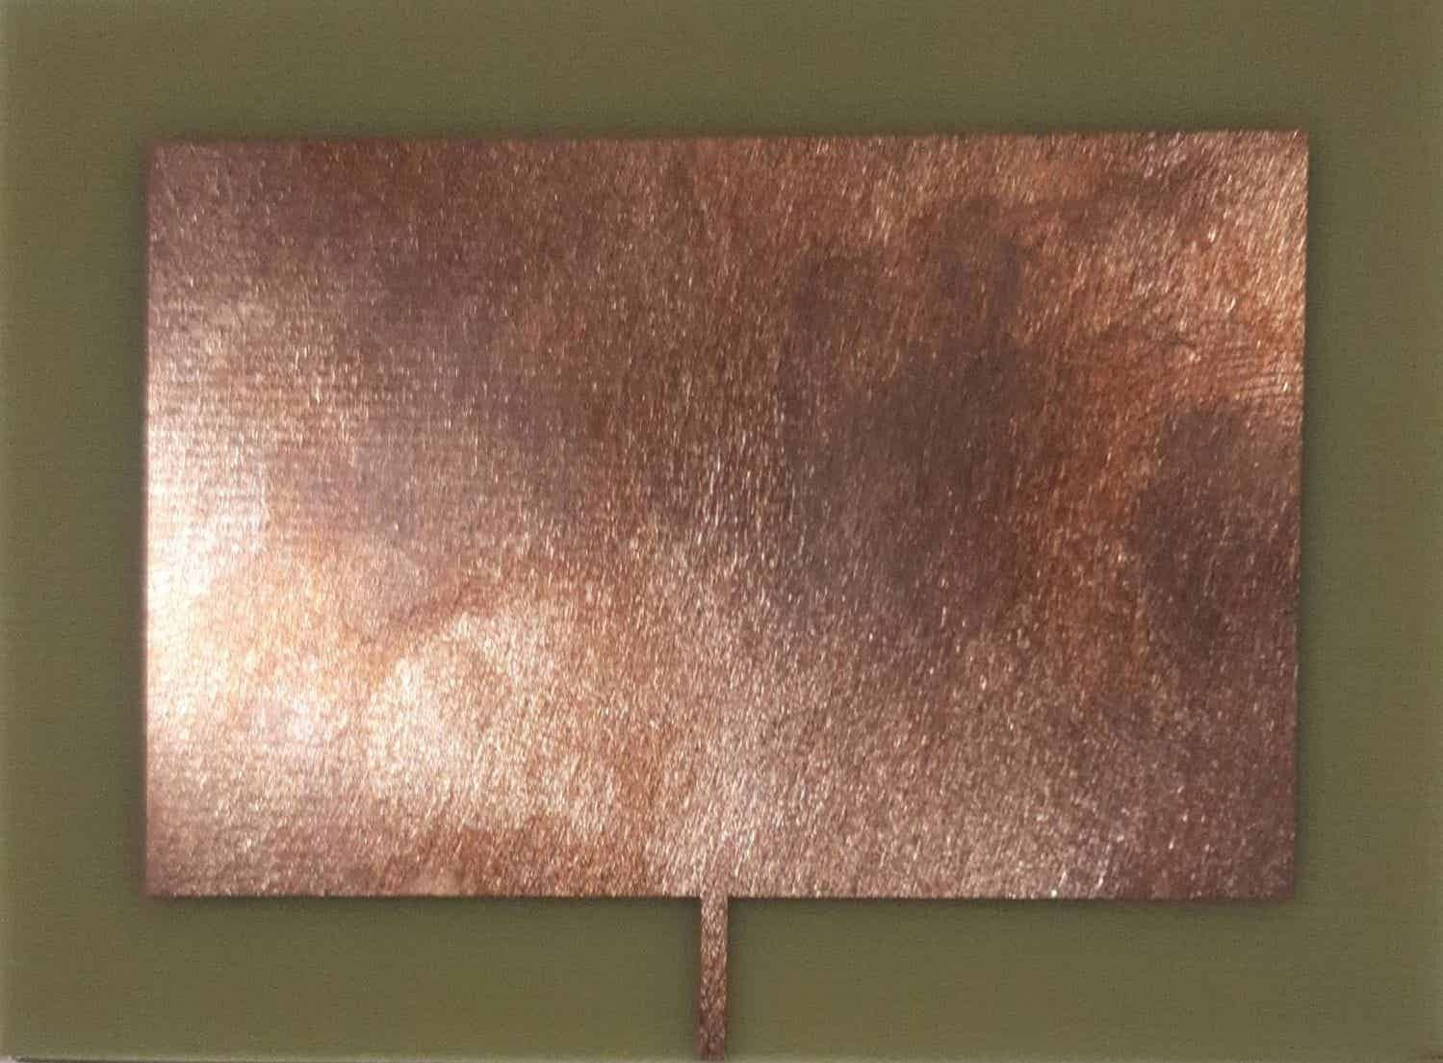
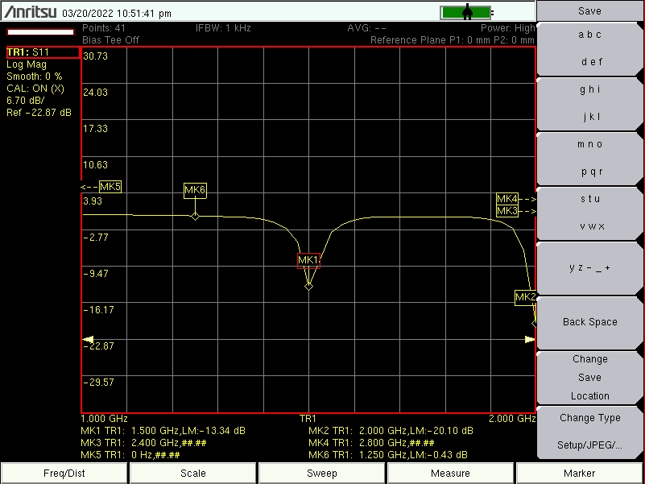
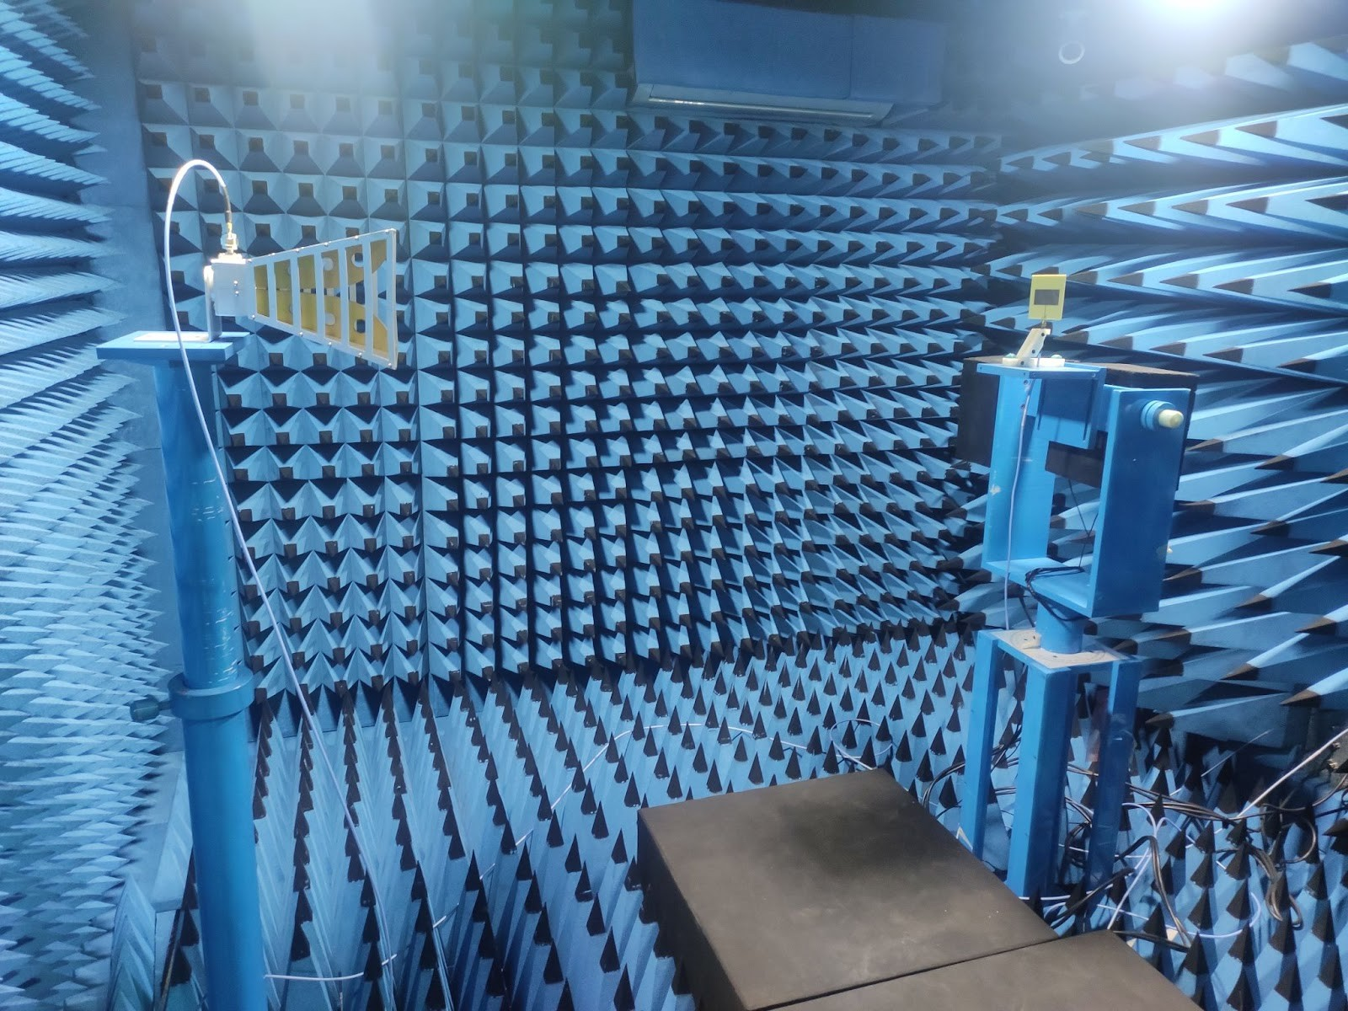
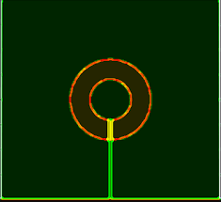
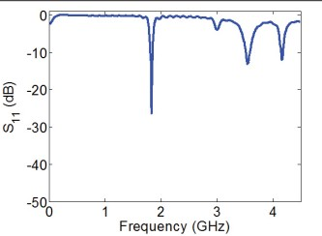
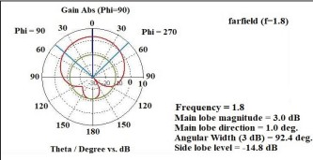
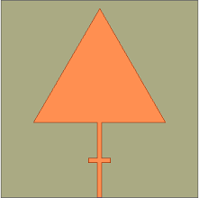
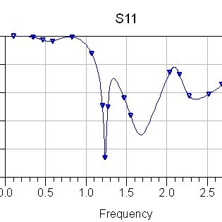
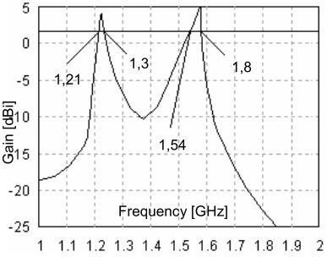
State Level Poster Competition Antenna: Theory to Practice
C ase Study of L1 Band Microstrip Patch Antenna
Prepared by:
Kirtan Dave
Miraj Bavishi
Internal Guide:
Dr. Namrata V. Langhnoja
Comparison of our prototype with other analogous antennas of L band:
Operating Frequency: 1.57542 GHz
Wavelength: 0.19 m ; Directivity: 6.37 dB ; Bandwidth(fH-fL): 1GHz; E_{r}=4.4(FR4)
Rectangular Patch | Circular Patch | Triangular Patch
L_{p} = 44 mm | Radius = 28.5 mm | Side = 64 mm
W_{p} = 67.94 mm
S₁₁ = -13.34 dB | S₁₁ = -9.89 dB | S₁₁ = -9.87 dB
Gain(simulated) = 2.3 dB | Gain(simulated) = 3 dB | Gain(simulated) = 2.9 dB
Gain(measured)= 1.36 dB
Design in HFSS
Return loss(simulated)
Gain Plot(simulated)
Return loss(measured)
Fabricated
Anechoic Chamber
Gain plot
Circular Patch
Return loss
Triangular Patch
Return loss
G vs f plot
Application: The GPS system (Global Positioning System) uses 24 satellites called for space vehicles (SV). The GPS receiver calculates the position in real time using the signal sent by SV satellite. To design a rectangular microstrip patch antenna we decide the substrate material and the thickness of it. Frequency of GPS signal is 1575.42 MHz; Set these parameters as follows: E_{r=}=4.1; h=1.6mm; f=1.57542GHz; W=59.716mm; L=46.798mm; Then we get VSWR = 1.183678, loss factor = 0.007075 (magnitude) or -21.506 dB.

